Slide 1




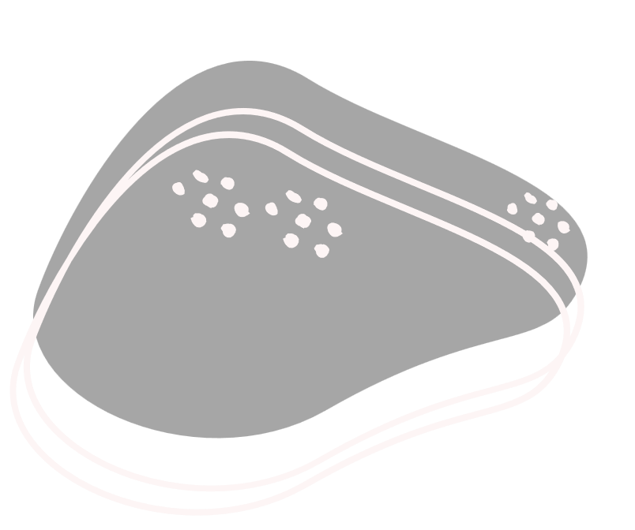

Pet yard
Supervised by
Dr. Lamiaa AboZaid

Slide 2
Agenda
01
02
03
04
Introduction
Motivation
Challenges
Stakeholders
05
06
07
08
Design and Architecture
Related work
Requirements
Demo

Slide 3
01
Introduction

Slide 4

Hello!
Our project focuses on addressing the challenges present within the pet care service industry, particularly in Egypt, where there is a lack of applications connecting pet owners with reliable and convenient pet care service providers. After noticing this gap, we decided to develop our application and fill this gap by providing the services that a lot of pet owners need, which are pet walking, sitting, and boarding to name a few.

Slide 5
02
Motivation

Slide 6
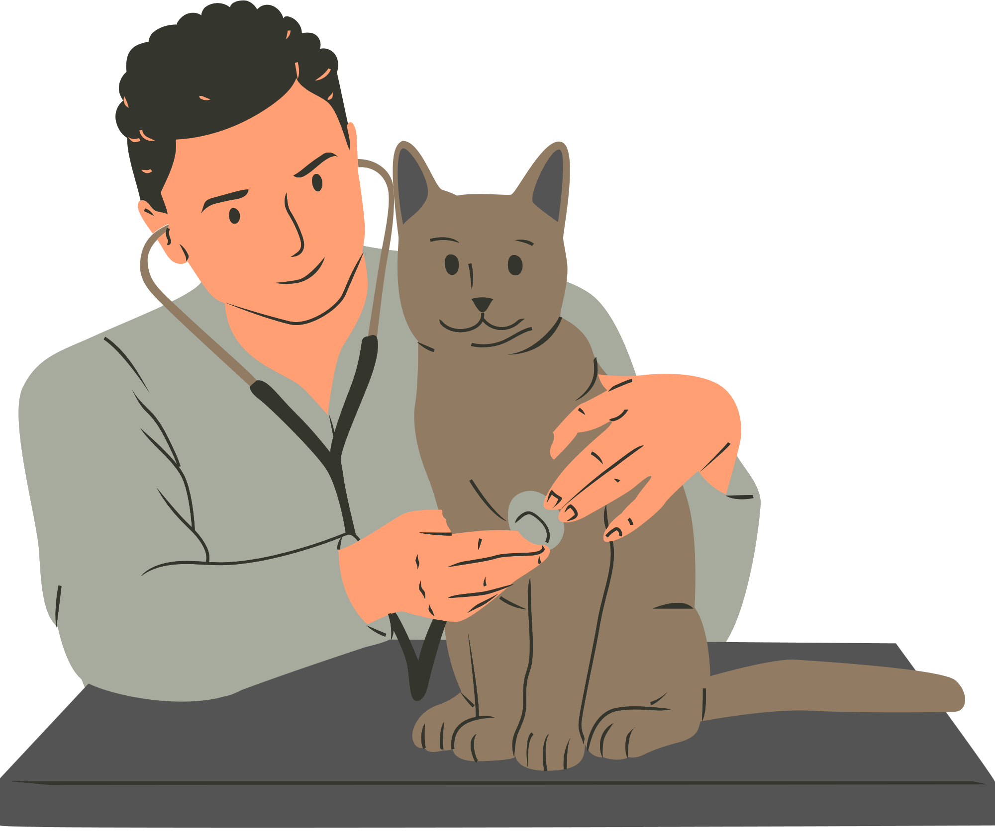
Motivation
As animal lovers, we understand the importance of ensuring the well-being and happiness of pets. we are motivated to solve this problem to create a solution that simplifies the process of finding and booking quality pet care services. By providing a centralized platform that connects pet owners with trusted service providers, we aim to alleviate the stress and uncertainty associated with pet care arrangements. Our goal is to facilitate seamless and enjoyable experiences for both pet owners and service providers.

Slide 7
03
Challenges

Slide 8
04
Stakeholders

Slide 10
05
Related Work

Slide 11
Related Work
 | Pet Backer (web site and app) | Rover (web site) | Trusted house sitters (website) | Egy puppy (website) | Pet yard (App)
Grooming |  | X | X
Sitting |  |  |  | X
Boarding |  |  |  | X
Pet Walking |  |  | X | X
Day care |  |  | X | X | X
Pet taxi |  | X | X | X | X
Selling goods | X | X | X
Drop-in visits |  |  | X | X | X
Health care | X | X | X

Slide 12
Related Work
 | Pet Backer (web site and app) | Rover (web site) | Trusted house sitters (website) | Egy puppy (website) | Pet yard (App)
Grooming |  | X | X
Sitting |  |  |  | X
Boarding |  |  |  | X
Pet Walking |  |  | X | X
Day care |  |  | X | X | X
Pet taxi |  | X | X | X | X
Selling goods | X | X | X
Drop-in visits |  |  | X | X | X
Health care | X | X | X

Slide 13
06
Requirements

Slide 14
Functional Requirements
1
2
3
4
5
6
Authentication
Make pet
Profile
Service
browsing
Grooming
service
Sitting
service
Grooming
service

Slide 15
Functional Requirements
7
8
9
10
11
Boarding
service
Reservation Management
Online
Health
Reviews
and Ratings
store
care

Slide 16
Non-Functional Requirements
Performance | Usabiltiy | Security | Maintainability
Response time Throughput Scalability Reliability | User interface | Authentication Authorization Data integrity | Modularity Documentation

Slide 17
07
Design and Architecture

Slide 18
Diagrams
1
2
3
4
5
System Architecture
Use Case
Diagram
Class Diagram
Sequence
Diagram
ERD

Slide 19
System Architecture

Slide 20
Use Case Diagram

Slide 21
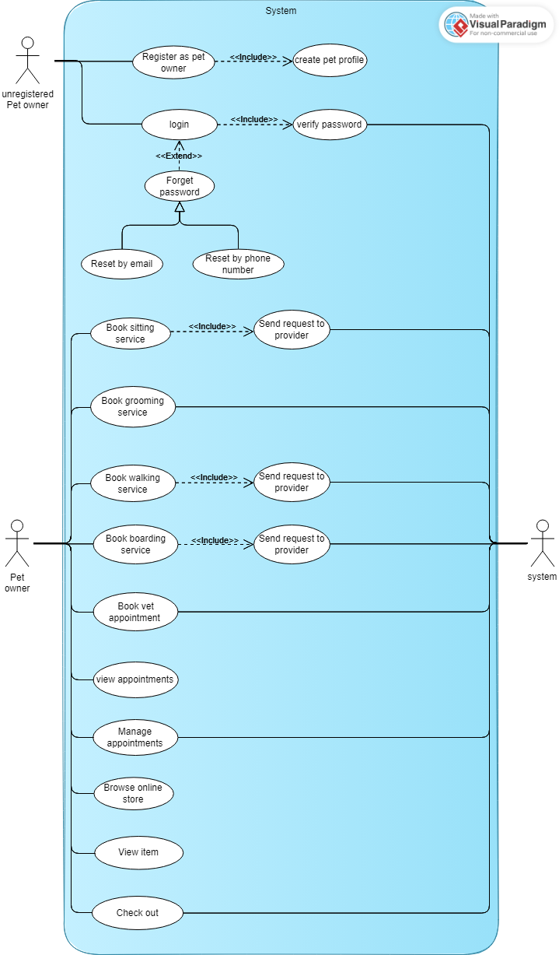
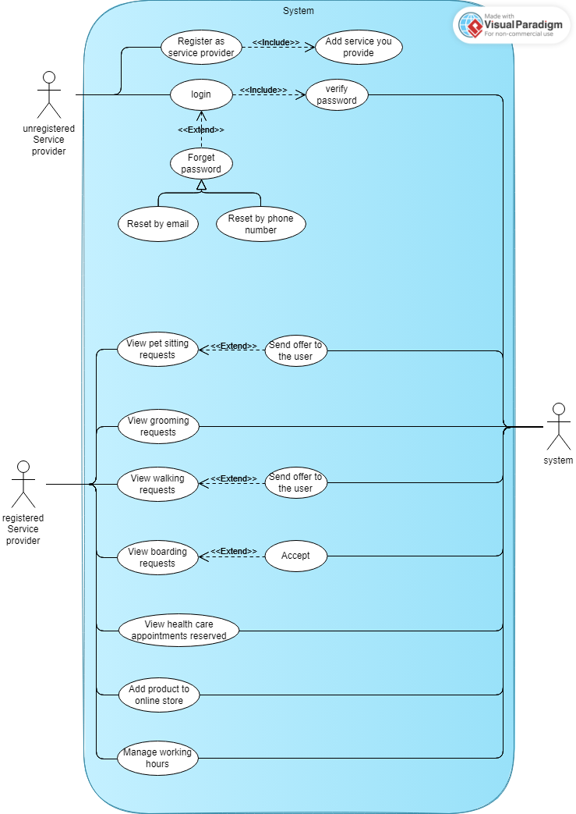
Use Case Diagram

Slide 22
Use Case Diagram

Slide 23
Class Diagram

Slide 24
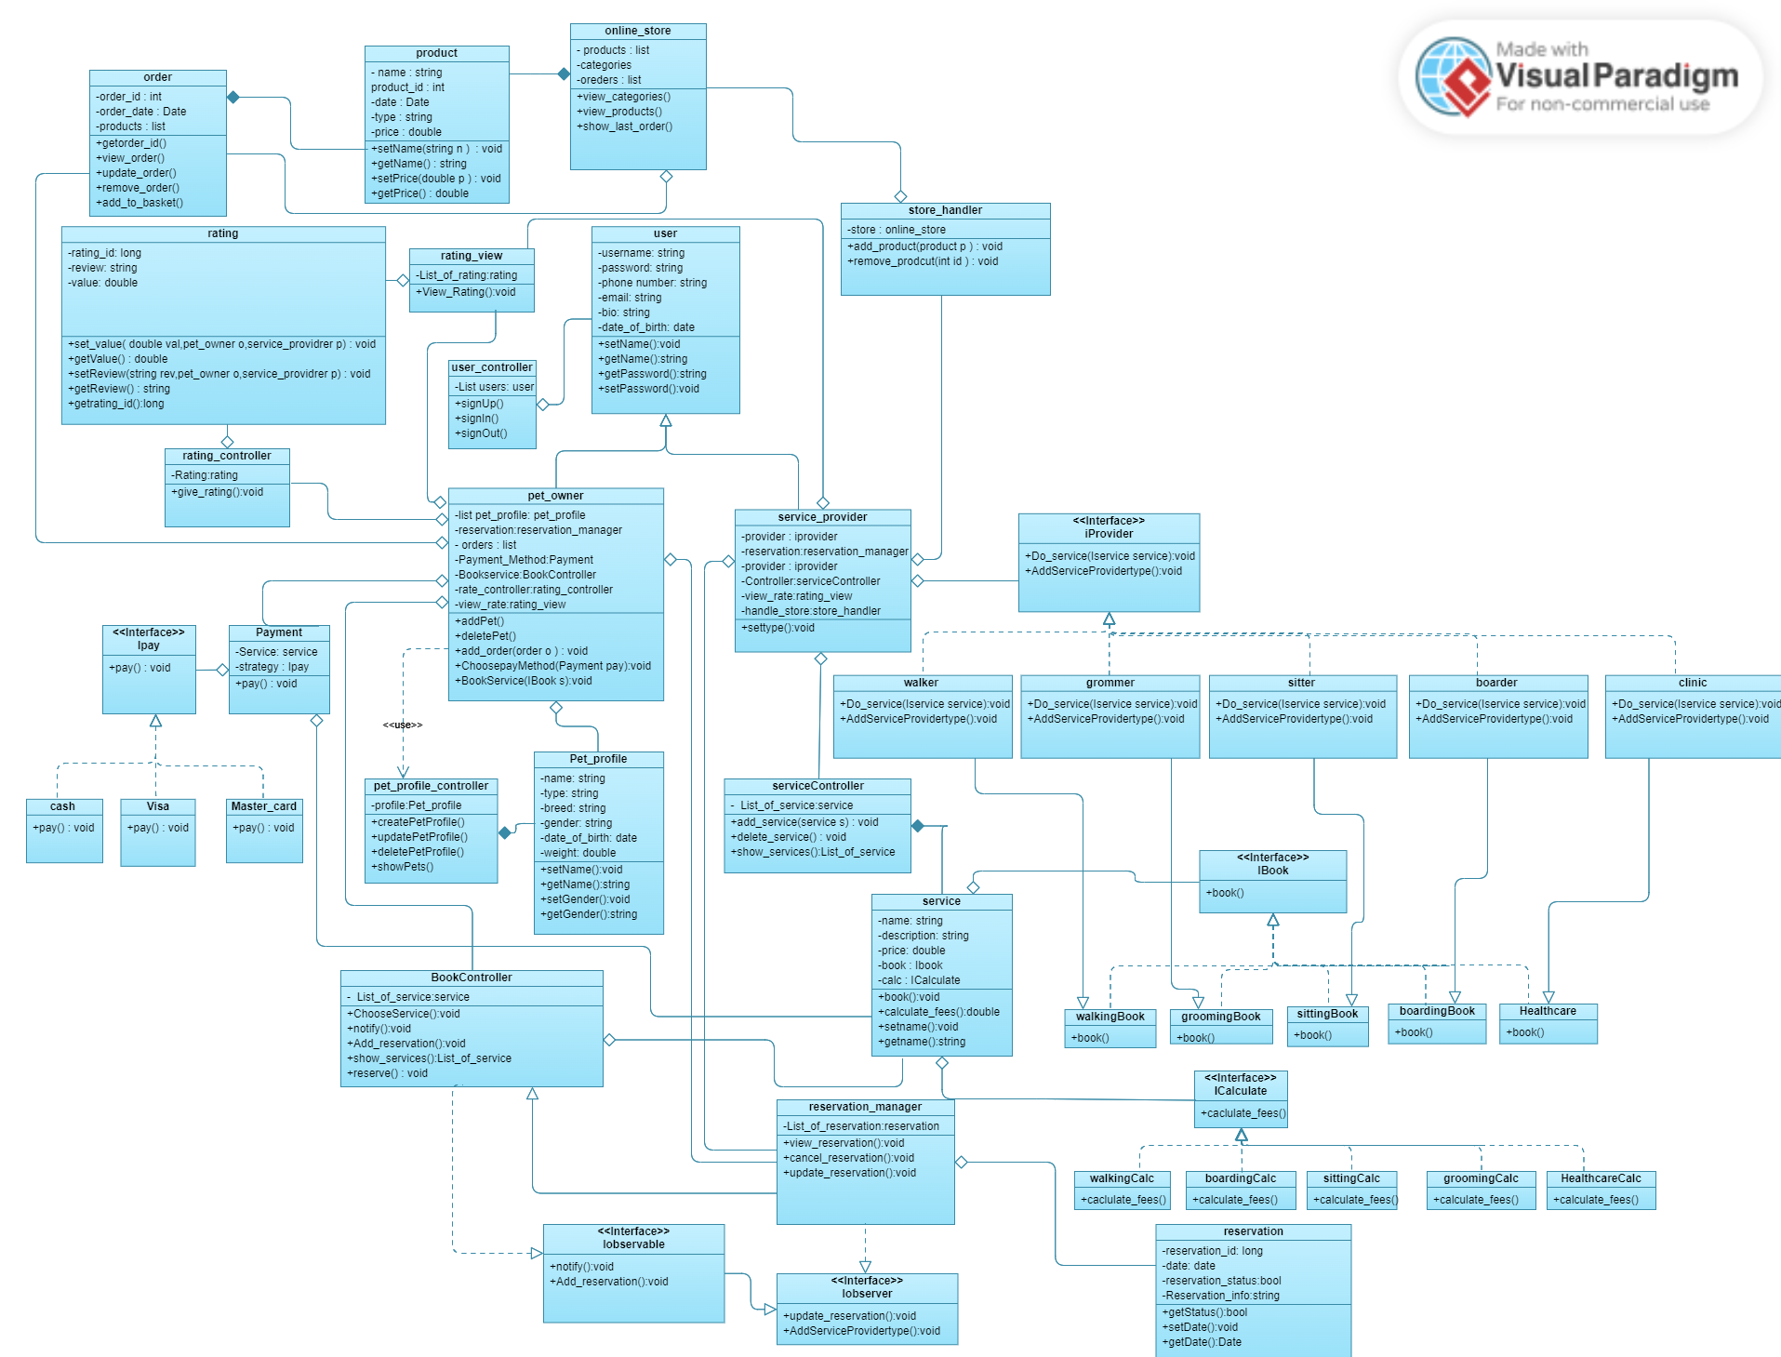
Class Diagram

Slide 25
Class Diagram

Slide 26
Sequence Diagram

Slide 27
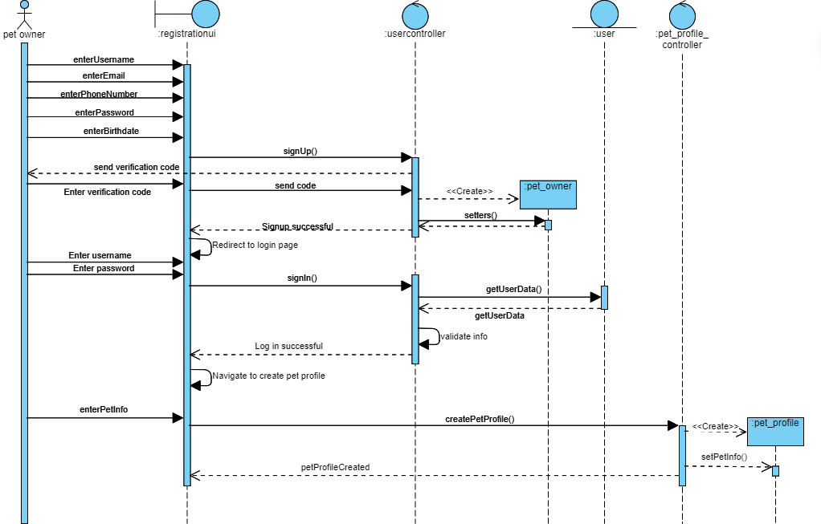
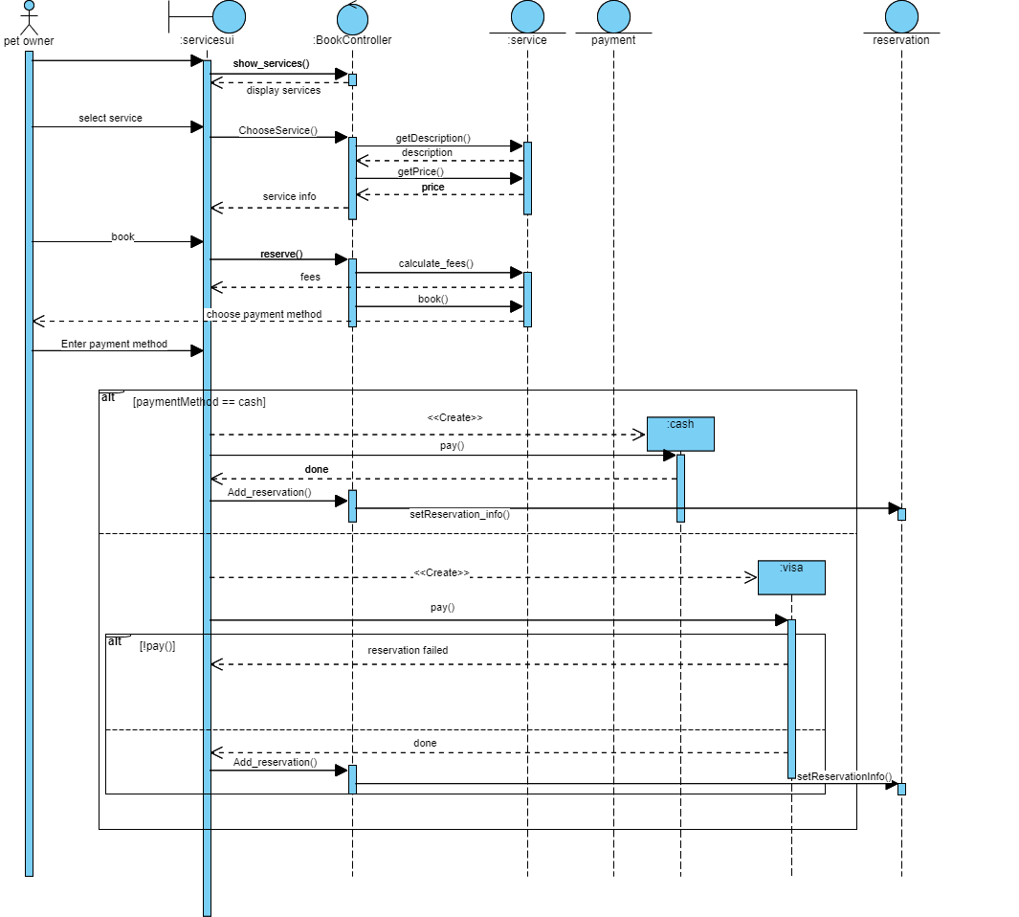
Sequence Diagram

Slide 28
Sequence Diagram

Slide 29
ERD

Slide 30
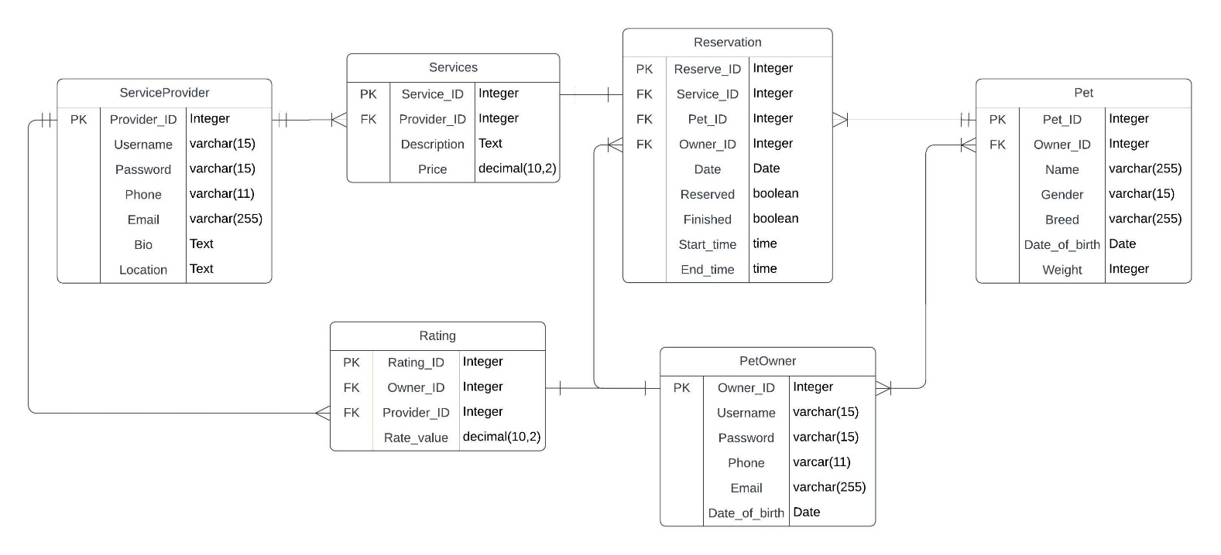
ERD

Slide 31
ERD

Slide 32
08
Demo

Slide 34
Thank's
For Watch
PET YARD

